Slide 1
Lloyd Garrison School

Slide 2
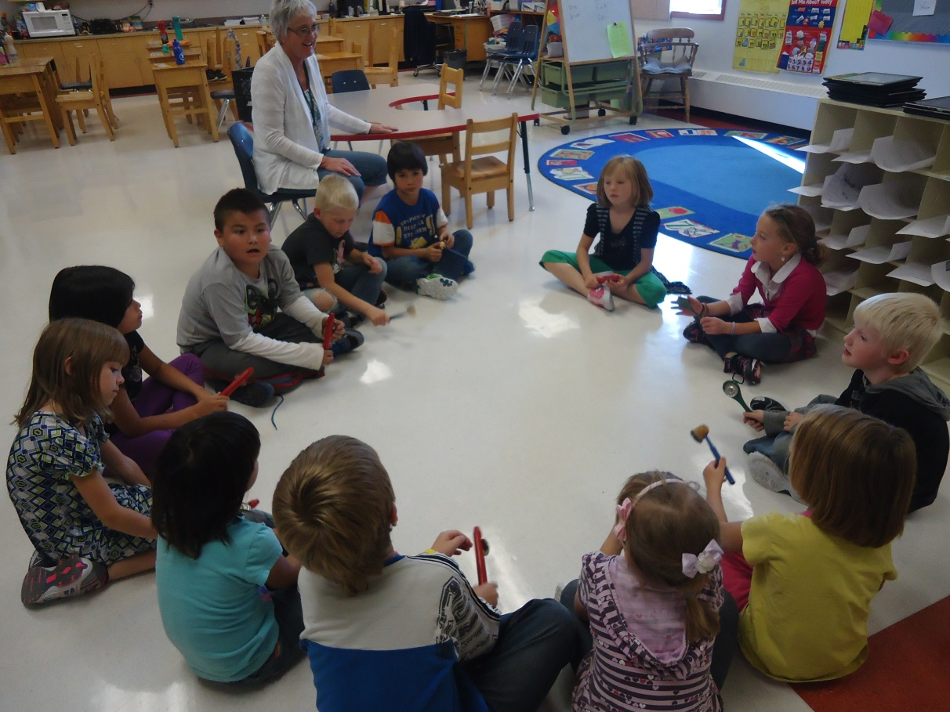
VISION STATEMENT
At Lloyd Garrison School we will provide opportunities for learning that foster growth and success for each individual learner.

Slide 3
Values:
Belonging: Creating mutually beneficial relationships amongst students, staff, parents and community members unites us with common goals.

Slide 4
Values:
Excellence in learning: Setting high expectations within a positive environment will lead to high levels of achievement.

Slide 5
Values:
Accountability: Ownership and accountability for one’s learning and behaviour results in academic success.

Slide 6
Values:
Respect: Treating others with kindness and dignity and caring for their learning.

Slide 7
Values:
Safety: We believe that a safe and caring environment creates emotional and physical safety for all.

Slide 8
Individualized Language/Math Groupings

Slide 9
Leadership Skills

Slide 10
Citizenship

Slide 11
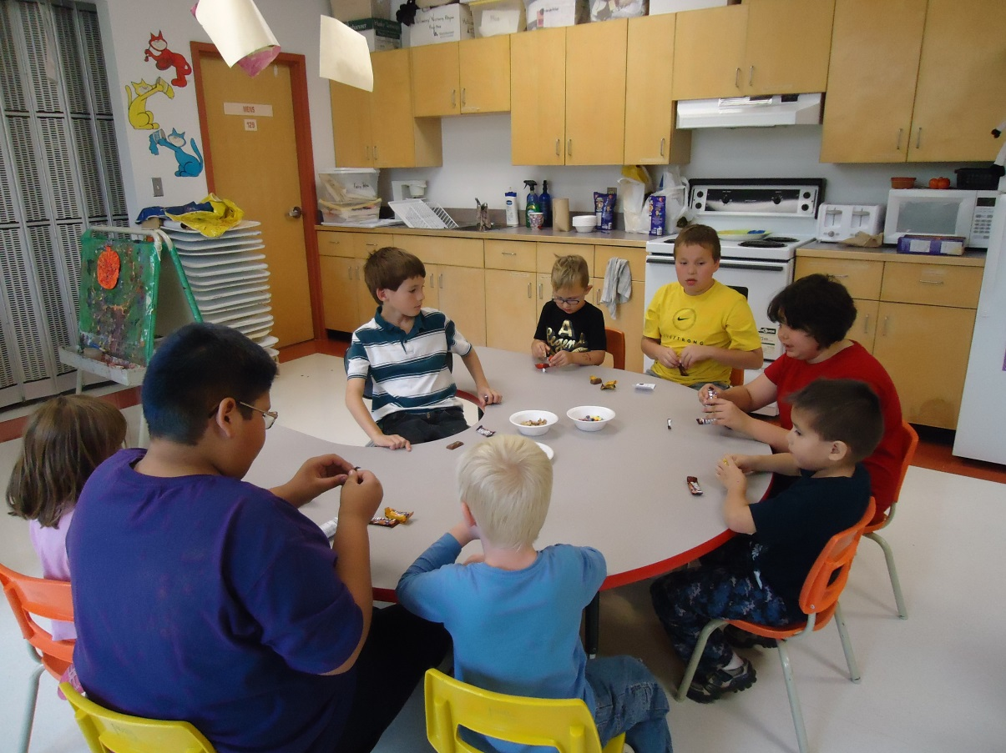
Work Preparation

Slide 12
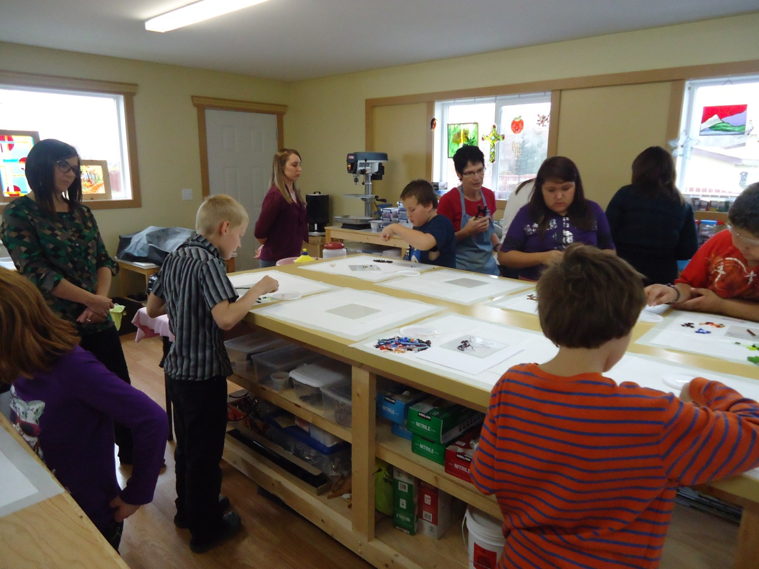
Fine Arts Options

Slide 13
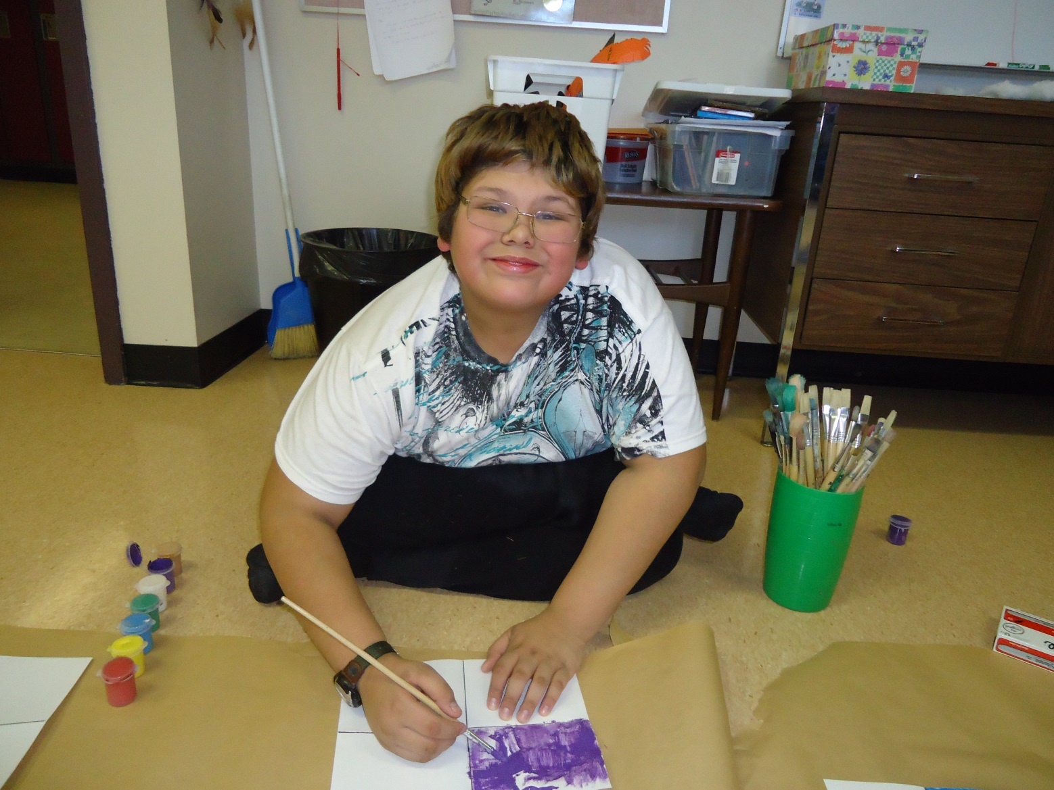
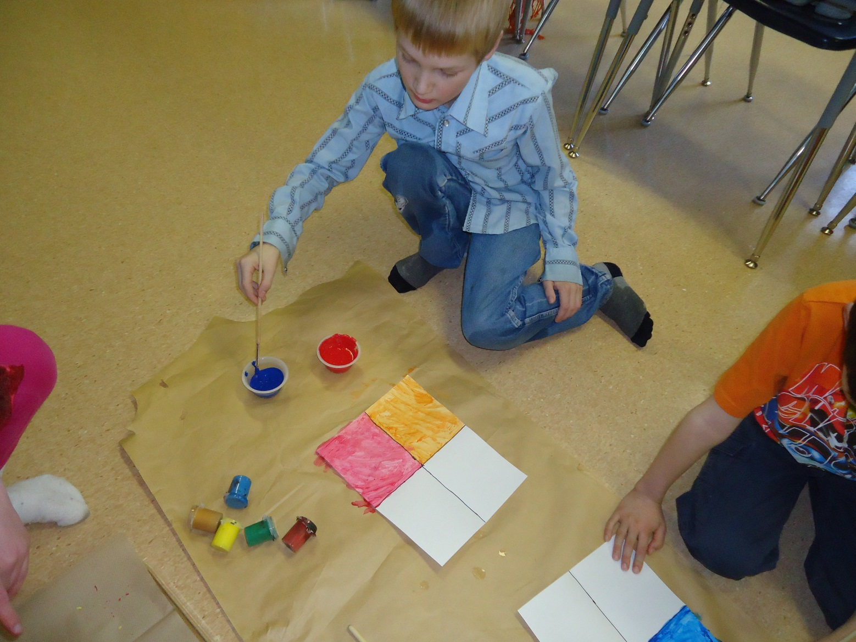
Fine Arts Options

Slide 14
Music Program

Slide 15
Daily Physical Activity

Slide 16
Daily Physical Activity

Slide 17
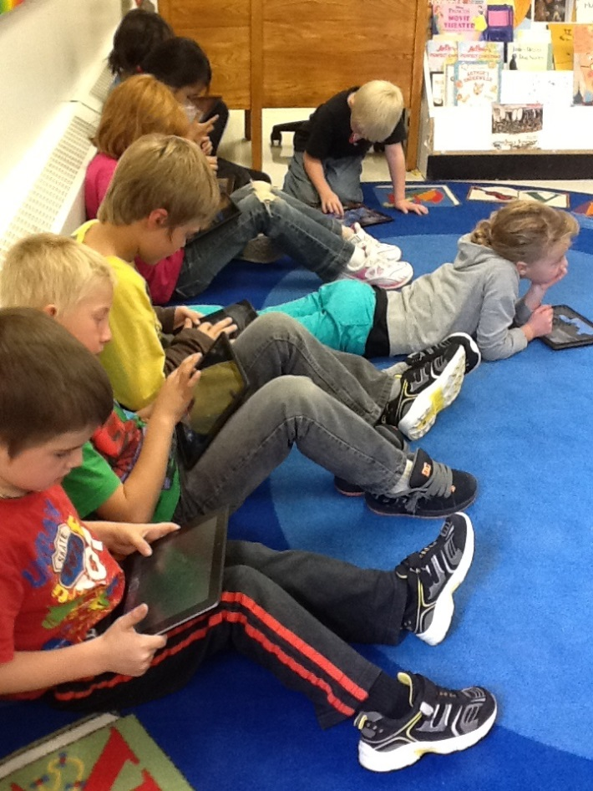
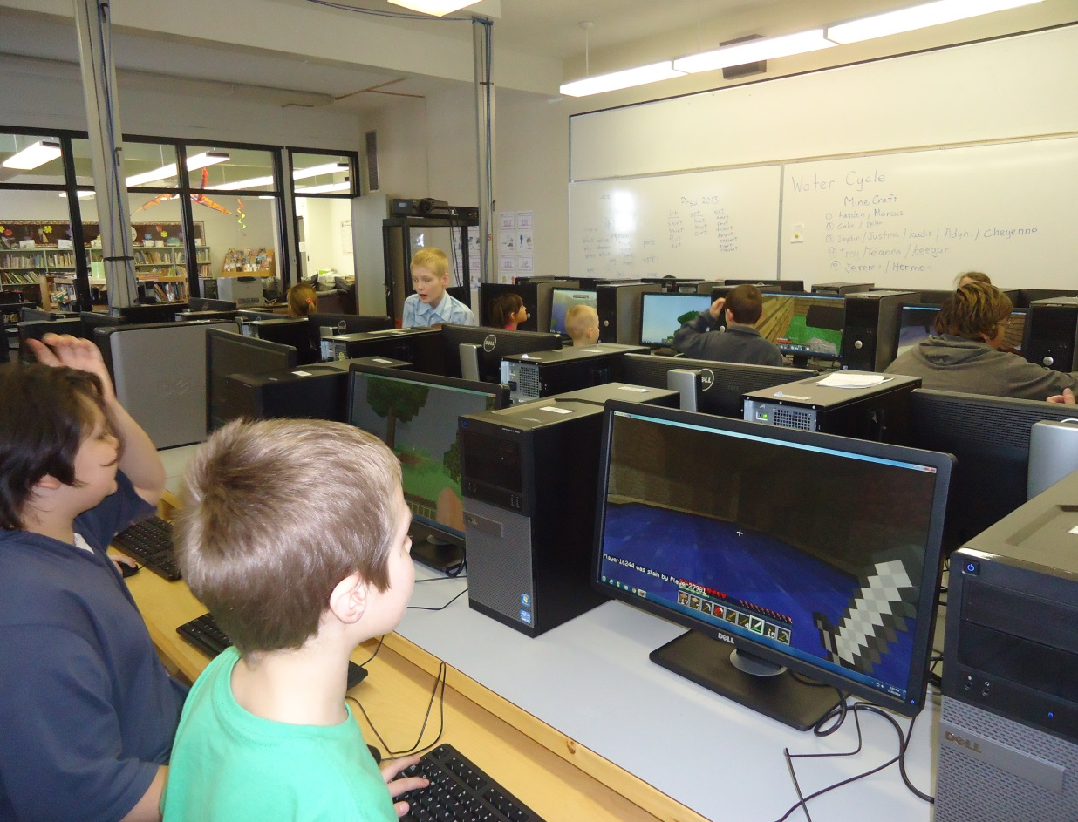
Technology

Slide 18
Low Teacher to Student Ratio…Small Class Sizes

Slide 19
Safe and Caring

Slide 20
